Slide 1


Seyed Mohammad Ahmadi
May 26 2023

Slide 2

Outline
Executive Summary
Introduction
Methodology
Results
Conclusion
Appendix

Slide 3
Executive Summary
Introduction
Summary of methodologies
Data Collection & Data Wrangling
EDA & Interactive Visual Analytics Methodology
Predictive Analysis Methodology
EDA with Visualization Results
EDA With SQL Results
Interactive Map with Folium Results
Plotly Dashboard Results
Predictive Analysis (Classification) Results
Summary of all results

Slide 4
Introduction
Project background and context
SpaceX advertises Falcon 9 rocket launches on its website with a cost of 62 million dollars; other providers cost upwards of 165 million dollars each, much of the savings is because SpaceX can reuse the first stage.
Problems you want to find answers
If we can determine if the first stage will land, we can determine the cost of a launch

Slide 5

Section 1

Slide 6
Methodology
Executive Summary
Data collection methodology:
SpaceX Rest API
Web Scrapping from SpaceX Wikipedia webpage
Perform data wrangling
Hot Encoding data fields
Data Cleaning: Correcting and Cleaning null values & irrelevant columns
Perform exploratory data analysis (EDA) using visualization and SQL
Perform interactive visual analytics using Folium and Plotly Dash
Perform predictive analysis using classification models
Different algorithm such as: Logistic Regression, K-Nearest Neighbors, Support Vector Machine, Decision Tree model have been deployed and evaluated to find the best method.

Slide 7
Data Collection
There are two methods that data are collected:
Used SpaceX Rest API
Returned SpaceX data
Normalized data int a csv file
Data Consolidation & Wrangling
1
Got HTML Response from Wikipedia webpage
Used BeautifulSoup to extract Data
Normalized data int a csv file
Data Consolidation & Wrangling
2

Slide 8
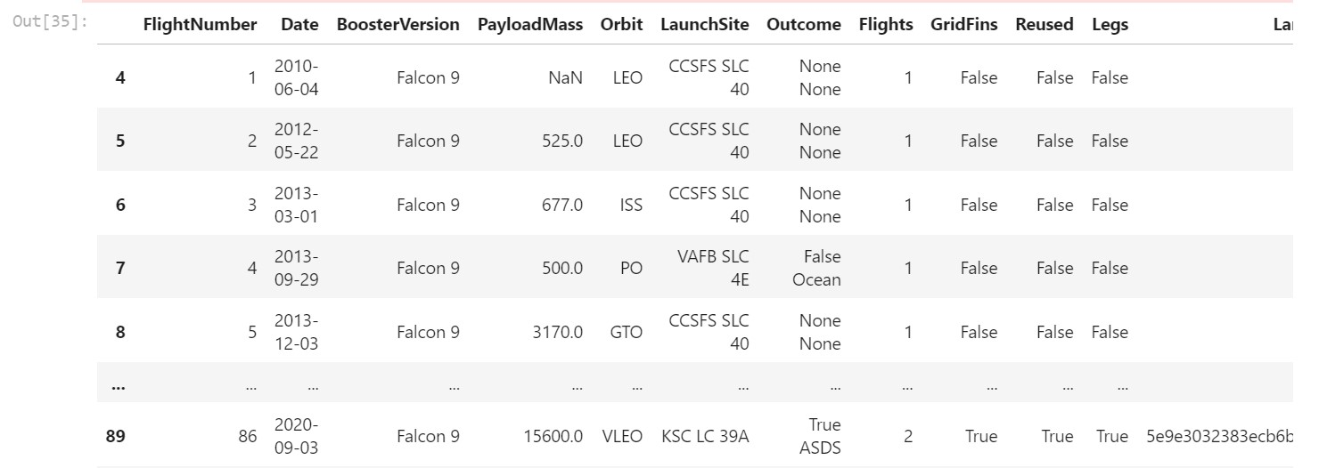
Data Collection – SpaceX API
Data collection with SpaceX REST calls
https://github.com/Mamad66Ahmadi/IBM-Data-Science-Capstone/blob/Module1/jupyter-labs-spacex-data-collection-api.ipynb

Slide 9
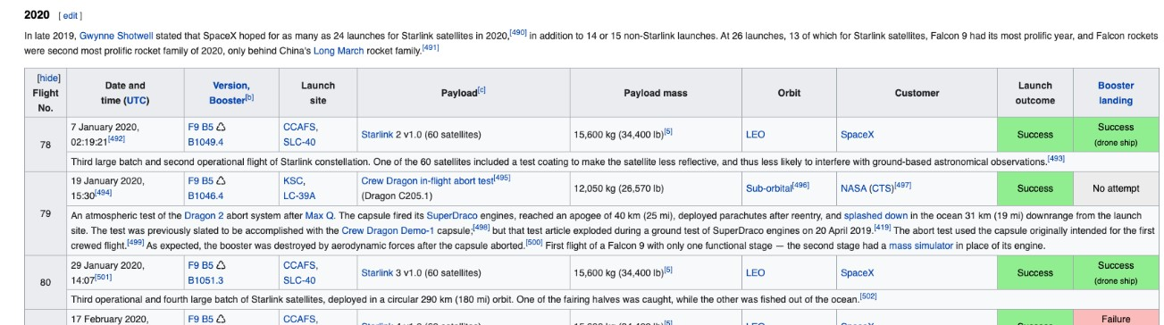
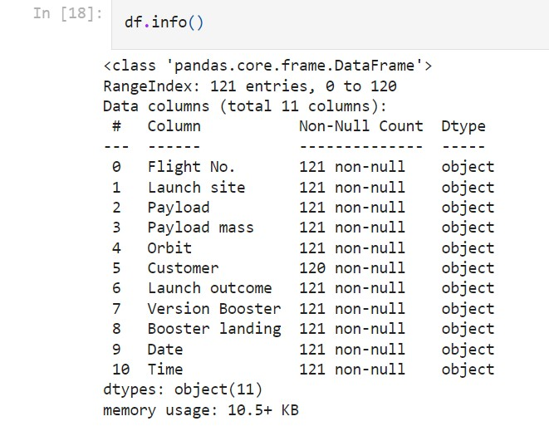
Data Collection - Scraping
Web scraping process
https://github.com/Mamad66Ahmadi/IBM-Data-Science-Capstone/blob/Module1/jupyter-labs-webscraping.ipynb

Slide 10
Data Wrangling
Determine Null Values
Determine the number of launches on each site
Determine the number and occurrence of each orbit
Determine the number of Landing_outcomes
Create a landing outcome label from Outcome column
Handle Null values
https://github.com/Mamad66Ahmadi/IBM-Data-Science-Capstone/blob/Module1/labs-jupyter-spacex-data_wrangling_jupyterlite.jupyterlite.ipynb

Slide 11
EDA with Data Visualization
For machine learning models we should get insight into the relationship between parameters. Therefore, various type of plots such as: Scatter plots, line charts, and bar plots are used to show the relation between different parameters.
Flight Number vs. Payload Mass
Flight Number vs. Launch Site
Payload Mass vs. Launch Site
Orbit vs. Success Rate
Flight Number vs. Orbit
Payload vs Orbit
Success Yearly Trend
https://github.com/Mamad66Ahmadi/IBM-Data-Science-Capstone/blob/Module2/jupyter-labs-eda-dataviz.ipynb.jupyterlite.ipynb

Slide 12
EDA with SQL
Displayed the names of the unique launch sites in the space mission
Displayed 5 records where launch sites begin with the string 'CCA'
Displayed the total payload mass carried by boosters launched by NASA (CRS)
Displayed average payload mass carried by booster version F9 v1.1
Listed the date when the first succesful landing outcome in ground pad was acheived.
Listed the names of the boosters which have success in drone ship and have payload mass greater than 4000 but less than 6000
Listed the total number of successful and failure mission outcomes
Listed the names of the booster_versions which have carried the maximum payload mass. Use a subquery
Listed the records which will display the month names, failure landing_outcomes in drone ship ,booster versions, launch_site for the months in year 2015.
Ranked the count of successful landing_outcomes between the date 04-06-2010 and 20-03-2017 in descending order.
https://github.com/Mamad66Ahmadi/IBM-Data-Science-Capstone/blob/Module2/jupyter-labs-eda-sql-coursera_sqllite.ipynb

Slide 13
Build an Interactive Map with Folium
with aim to finding an optimal location for building a launch site:
Calculated the distances between a launch site to its proximities
Marked down a point on the closest coastline using MousePosition and calculated the distance between the coastline point and the launch site
Drew a PolyLine between a launch site to the selected coastline point
Created a marker with distance to a closest city, railway, highway, etc.
Drew a line between the marker to the launch site
https://github.com/Mamad66Ahmadi/IBM-Data-Science-Capstone/blob/Module3/lab_jupyter_launch_site_location.jupyterlite.ipynb

Slide 14
Build a Dashboard with Plotly Dash
Dashboard with a selectable pie chart and a scatter plot.
Pie chart shows distribution of successful landings across all launch sites and can be selected to show individual launch site success rates.
The pie chart is used to visualize launch site success rate.
Scatter plot takes two inputs: All sites or individual site and payload mass on a slider between 0 and 10000 kg.
The scatter plot can help us see how success varies across launch sites, payload mass, and booster version category.
https://github.com/Mamad66Ahmadi/IBM-Data-Science-Capstone/blob/Module3/spacex_dash_app.py

Slide 15
Predictive Analysis (Classification)
Standardize the data
Use the function train_test_split to split the data X and Y into training and test data
Create different model objects then create a GridSearchCV
Calculate the accuracy on the test data using the method
Examining the confusion matrix
https://github.com/Mamad66Ahmadi/IBM-Data-Science-Capstone/blob/Module4/SpaceX_Machine_Learning_Prediction_Part_5.jupyterlite.ipynb

Slide 16
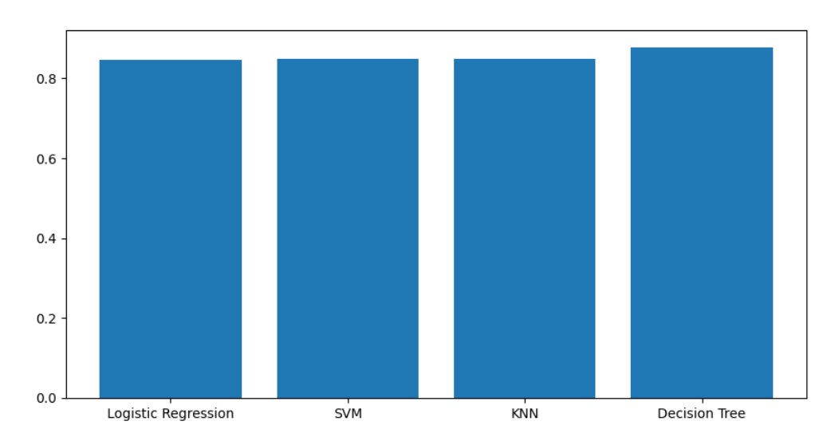
Results
The SVM, KNN, and Logistic Regression models are the best in terms of prediction accuracy for this dataset.
• Low weighted payloads perform better than the heavier payloads.
The success rates for SpaceX launches is directly proportional time in years they will eventually perfect the launches.
KSC LC 39A had the most successful launches from all the sites.
• Orbit GEO,HEO,SSO,ES L1 has the best Success Rate.

Slide 17

Section 2

Slide 18
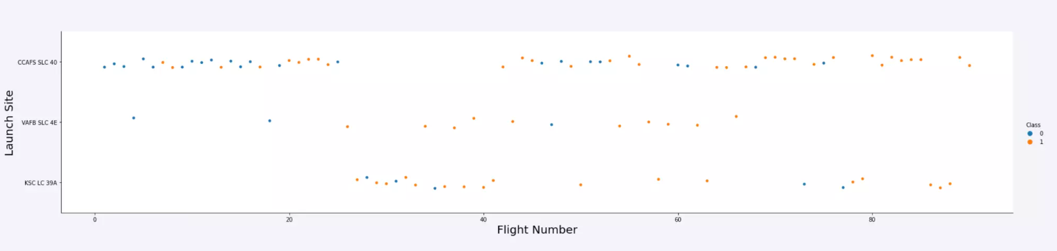
Flight Number vs. Launch Site
Launches from the site of CCAFS SLC 40 are significantly higher than lunches from other sites

Slide 19
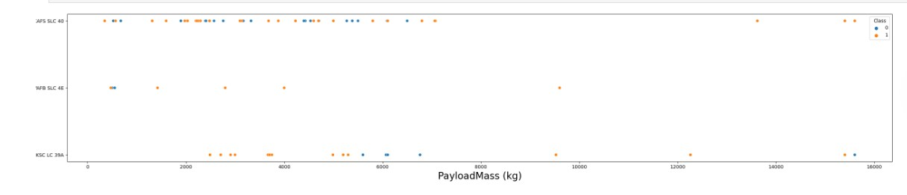
Payload vs. Launch Site
The majority of Pay Loads with lower Mass have been launched from CCAFS SLC 40.

Slide 20
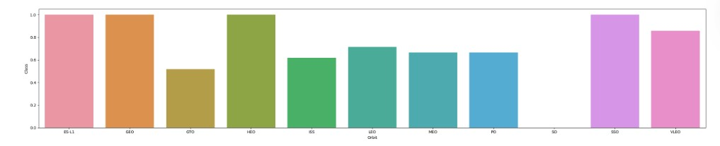
Success Rate vs. Orbit Type
ESL1, GEO, HEO and SSO orbits had the highest success rate.

Slide 21
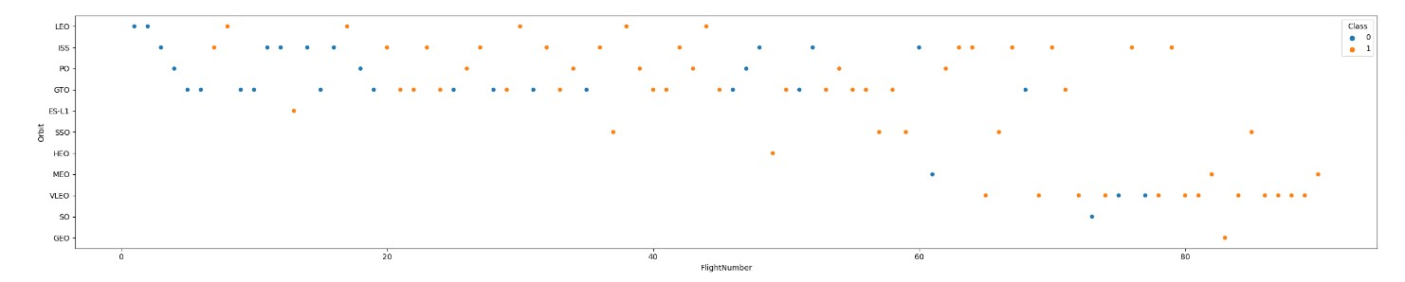
Flight Number vs. Orbit Type
There is an increasing rate of VLEO launches in recent years.

Slide 22
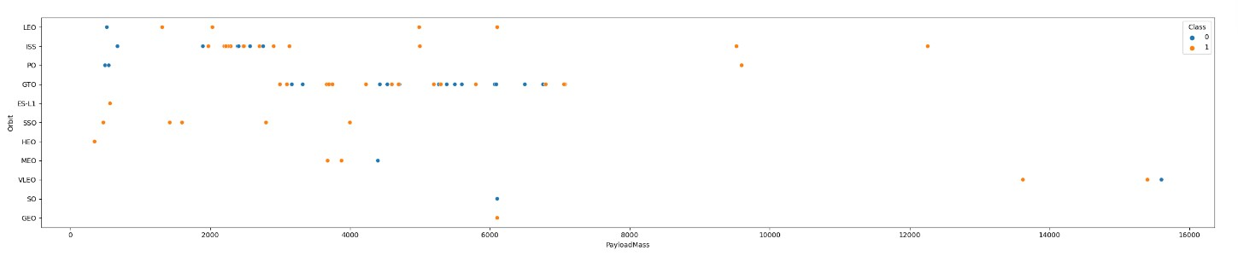
Payload vs. Orbit Type
At ISS most of payloads were around 2000
At GTO most of payload were between 3000 and 7000

Slide 23
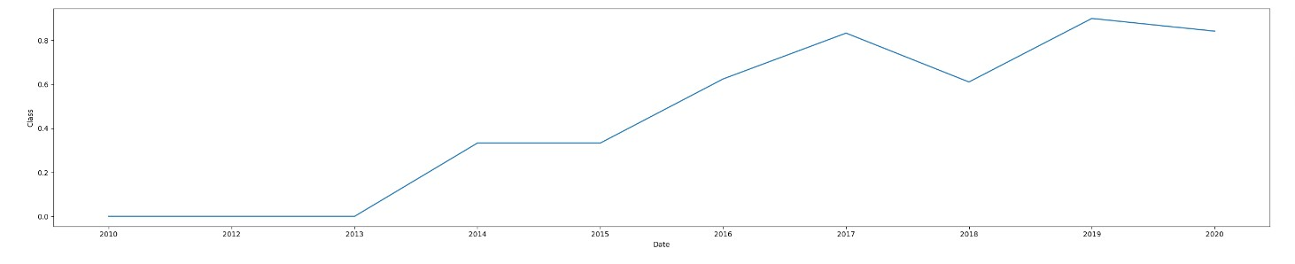
Launch Success Yearly Trend
Success rate has increased incredibly in recent years

Slide 24
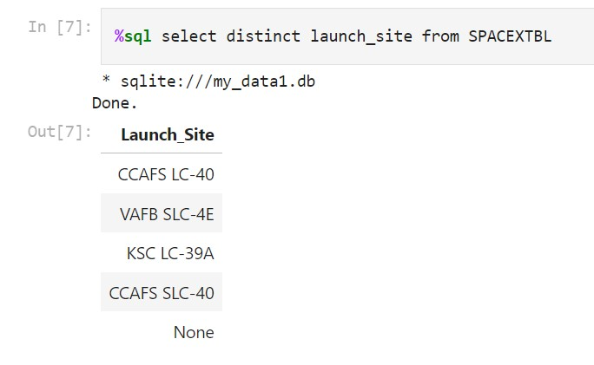
All Launch Site Names

Slide 25
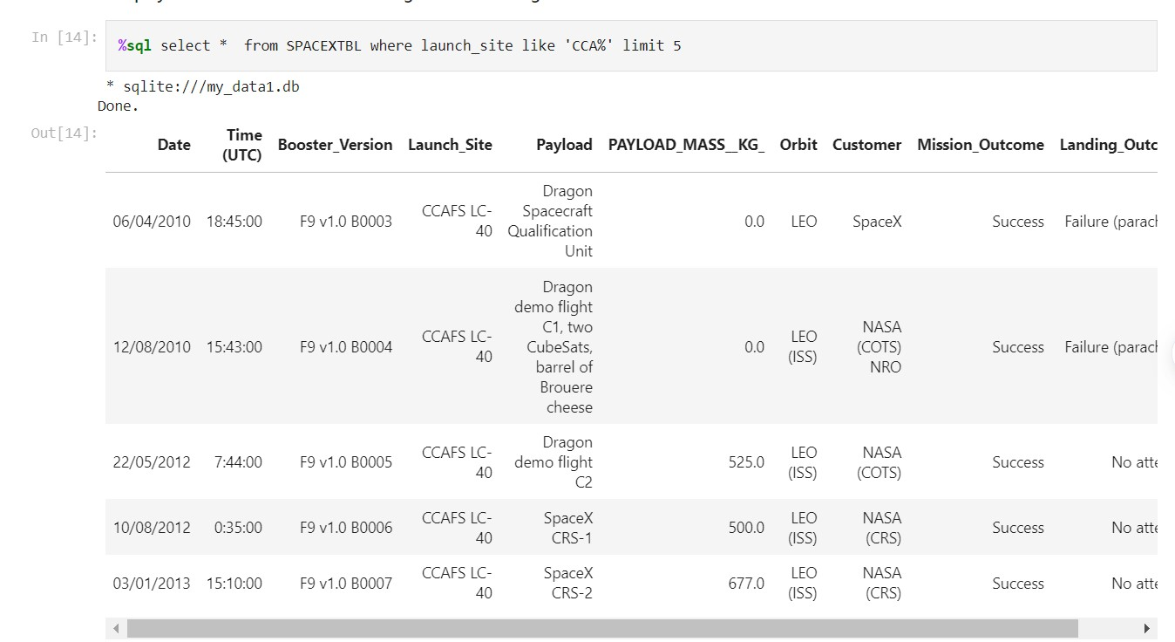
Launch Site Names Begin with 'CCA'

Slide 26
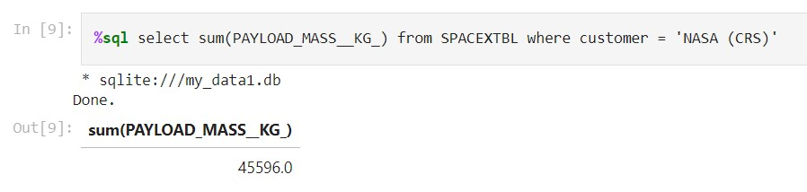
Total Payload Mass

Slide 27
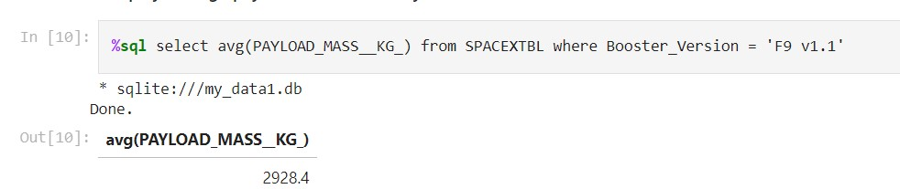
Average Payload Mass by F9 v1.1

Slide 28
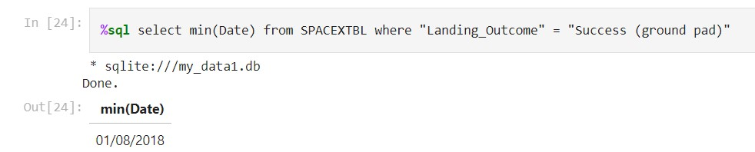
First Successful Ground Landing Date

Slide 29
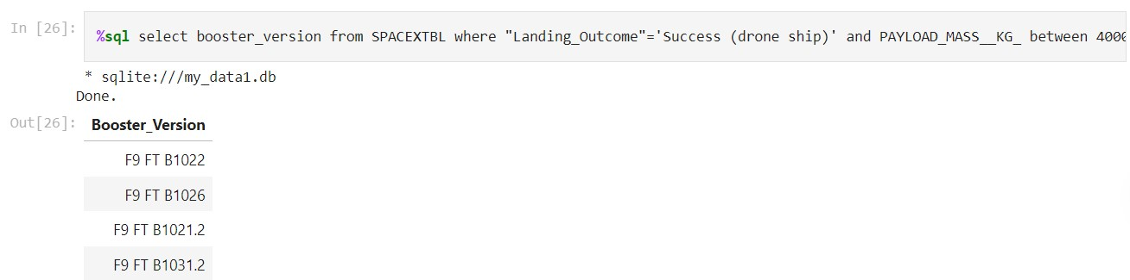
Successful Drone Ship Landing with Payload between 4000 and 6000
%sql select booster_version from SPACEXTBL where "Landing_Outcome"='Success (drone ship)' and PAYLOAD_MASS__KG_ between 4000 and 6000

Slide 30
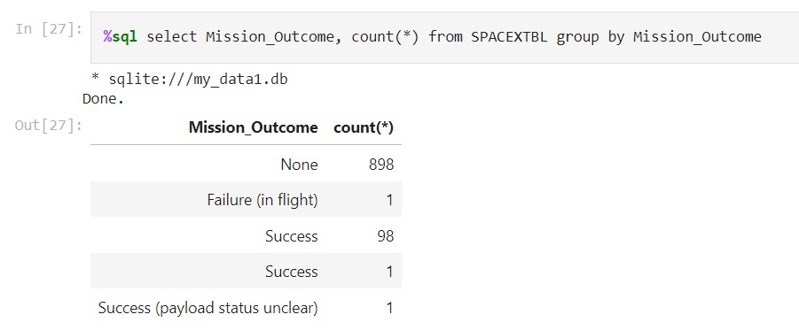
Total Number of Successful and Failure Mission Outcomes

Slide 31
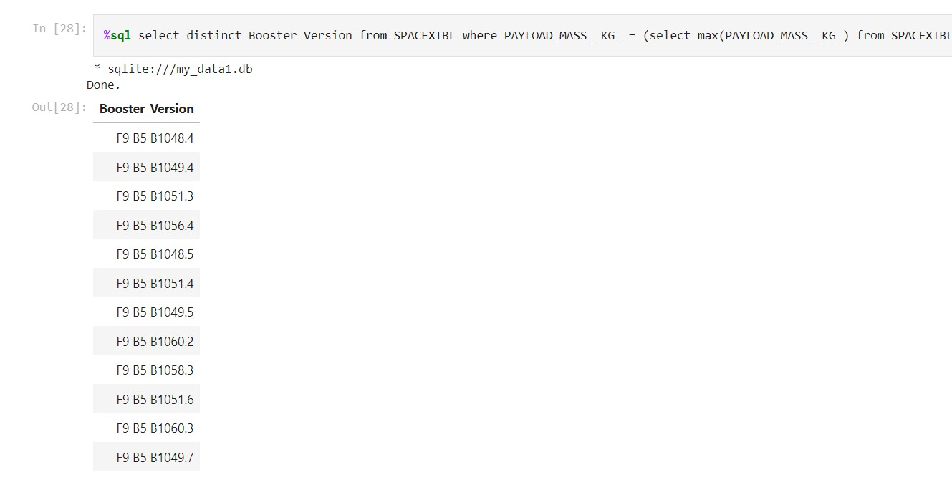
Boosters Carried Maximum Payload

Slide 32
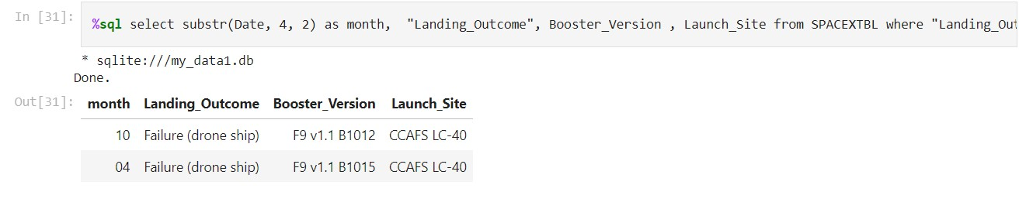
2015 Launch Records
%sql select substr(Date, 4, 2) as month, "Landing_Outcome", Booster_Version , Launch_Site from SPACEXTBL where "Landing_Outcome" = 'Failure (drone ship)' and substr(Date,7,4)='2015'

Slide 33
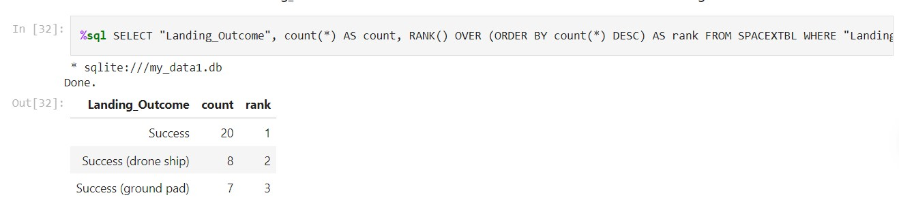
Rank Landing Outcomes Between 2010-06-04 and 2017-03-20
%sql SELECT "Landing_Outcome", count(*) AS count, RANK() OVER (ORDER BY count(*) DESC) AS rank FROM SPACEXTBL WHERE "Landing_Outcome" like 'Success%' and Date between '04-06-2010' and '20-03-2017' GROUP BY "Landing_Outcome" ORDER BY count DESC

Slide 34

Section 3

Slide 35
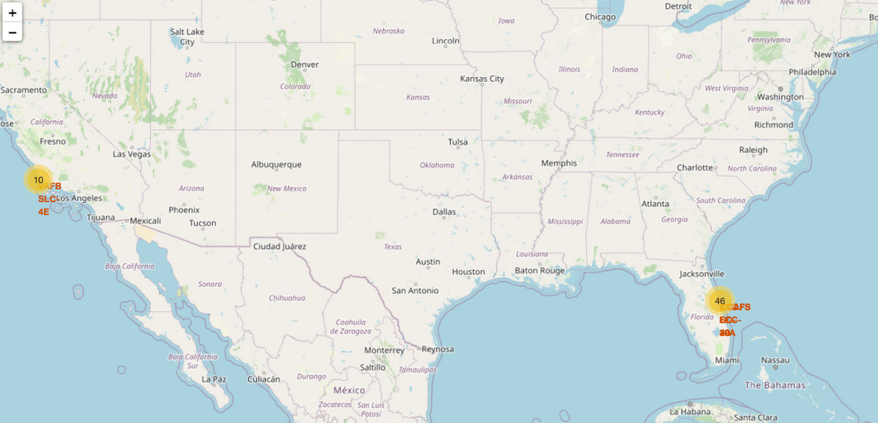
<Folium Map Screenshot 1>

Slide 36
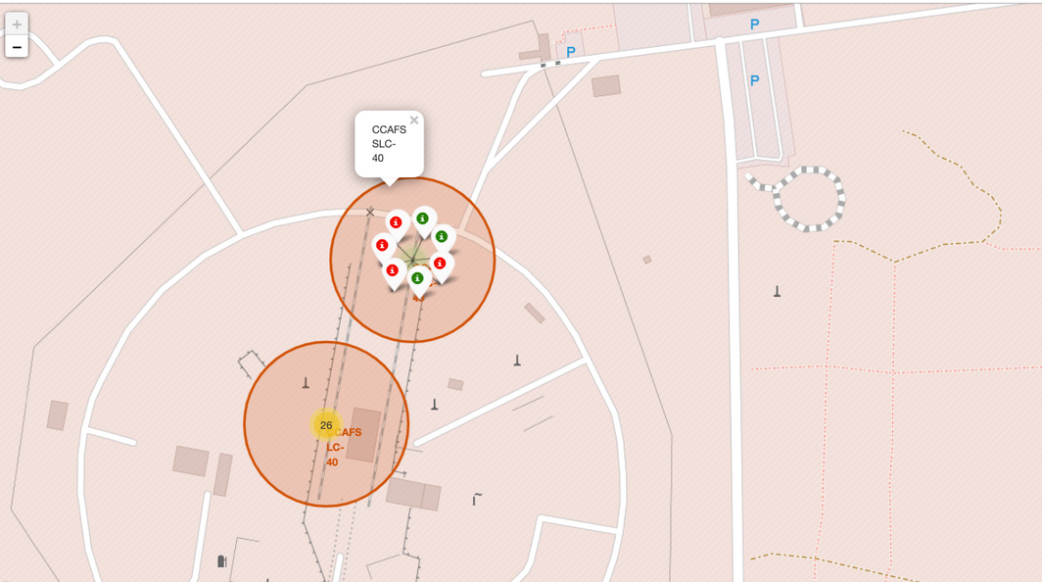
<Folium Map Screenshot 2>

Slide 37

<Folium Map Screenshot 3>

Slide 38

Section 4

Slide 39
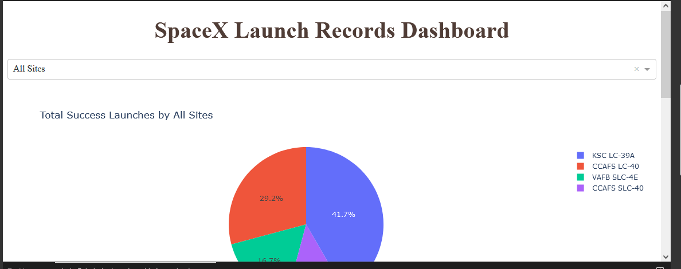
<Dashboard Screenshot 1>

Slide 40
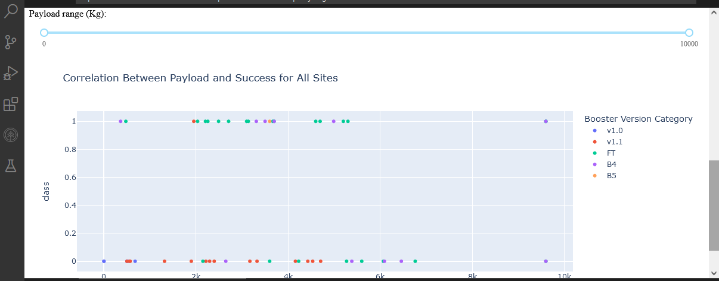
<Dashboard Screenshot 2>

Slide 41
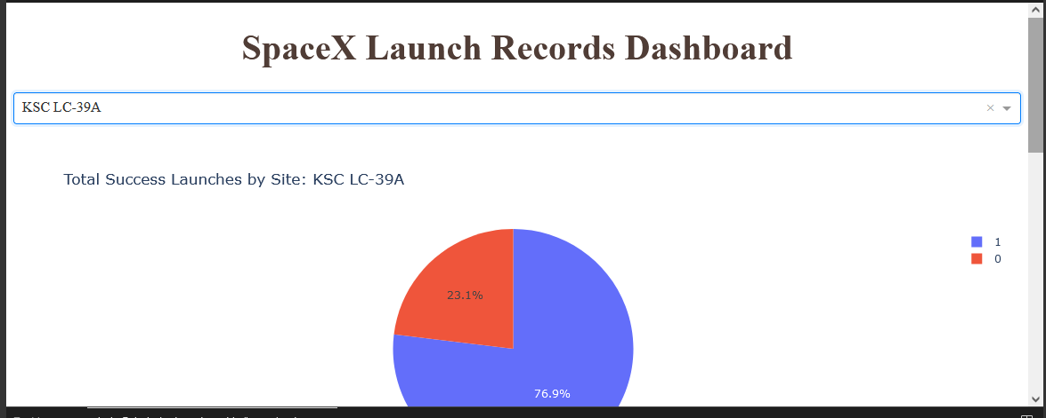
<Dashboard Screenshot 3>

Slide 42

Section 5

Slide 43
Classification Accuracy

Slide 44
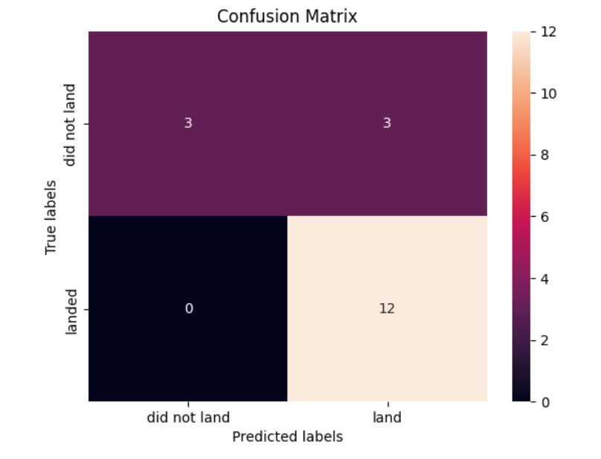
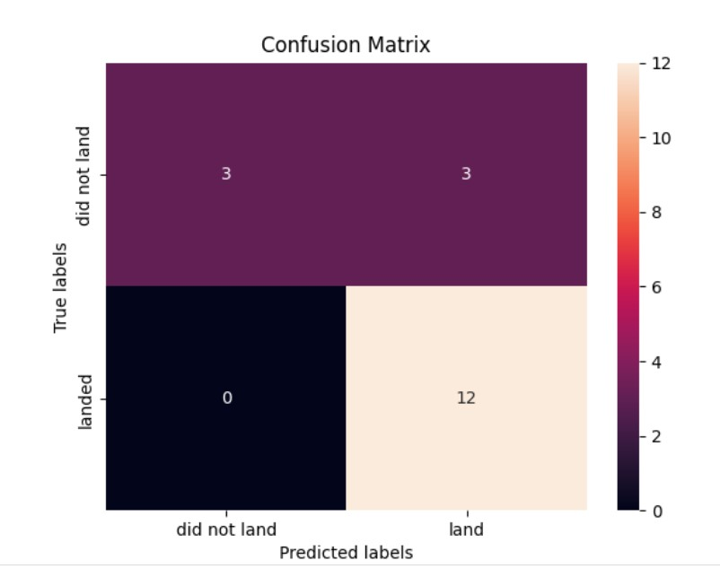
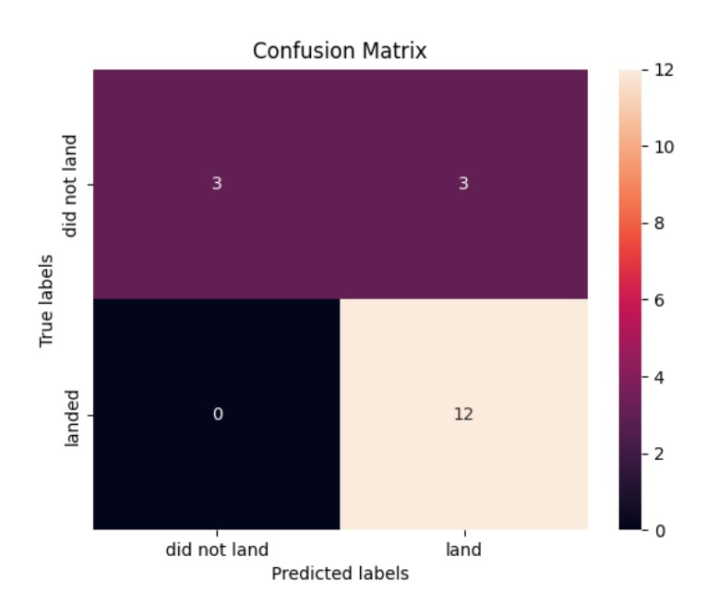
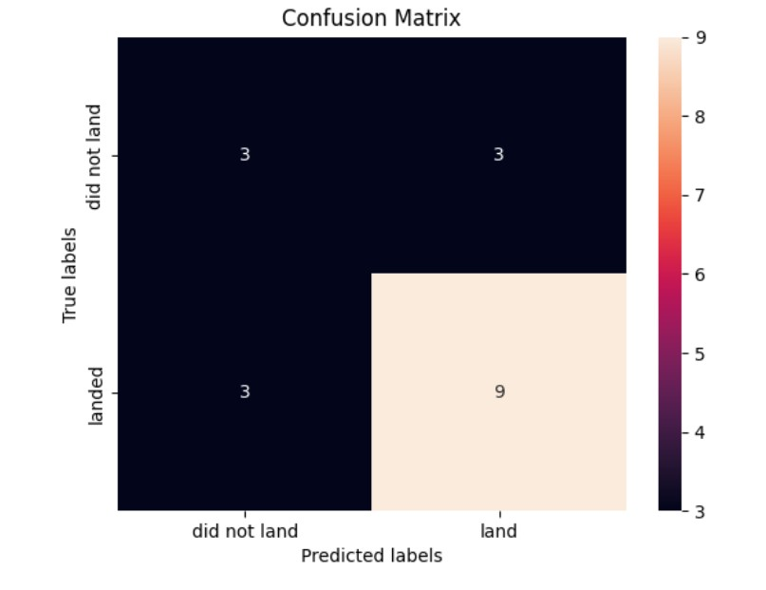
Confusion Matrix
Logistic Regression
SVM
Decision Tree
KNN

Slide 45
Conclusions
The Decision Tree model has the best prediction accuracy.
Low weighted payloads has a better success rate than the heavier payloads.
The success rates for SpaceX launches have increased significantly in recent years.
KSC LC 39A had the most successful launches among all other sites.
• Orbit GEO,HEO,SSO,ES L1 had the best Success Rate.

Slide 46
Appendix
Include any relevant assets like Python code snippets, SQL queries, charts, Notebook outputs, or data sets that you may have created during this project

Slide 47


